Slide 1
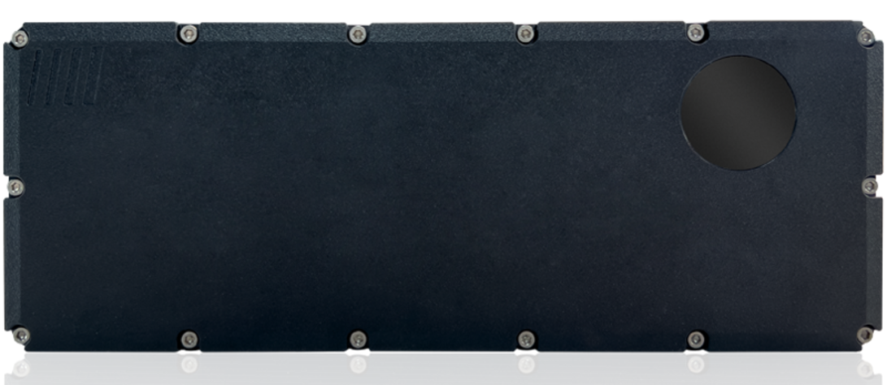
4D RADAR ITR-3810
Description
The ITR-3810 is a high-performance 4D radar for real-time object detection in automotive and robotics applications.
It operates in the 76-81 GHz millimeter-wave band, accurately detecting range, speed, angle, and elevation.
Ideal for all-weather conditions, it excels in low-visibility environments where optical sensors struggle.
Specifications
Operating Voltage - 24V to 48V
Detection Range - 20m
Operating Temperature : -40ºC to +80ºC
FoV - 110º Azimuth & 30º Elevation
Applications
Traffic Monitoring and Smart Infrastructure
Security and Surveillance
Intersection Management
Arterial Management
Official Website : https://www.innosent.de/en/radar-systems/itr-3810/

